Slide 1


BLUE JAYS
NEWS ARTICLE SENTIMENTAL ANALYSIS
Presented by
Group 7

Slide 2
AGENDA
TEAM MEMBERS
TOOLS USED
DATA SOURCES
DATA ACQUISITION
DATA STORAGE SENTIMENT ANALYSIS VISUALIZATION

Slide 3

TOOLS USED
WEB SCRAPING
DATA STORAGE AND SENTIMENT ANALYSIS
VISUALIZATION
THE NEWYORK TIMES
BBC NEWS
MONGO DB
PYTHON
TEXTBLOB
TABLEAU

Slide 4

DATA ACQUISITION
TOPIC SEARCH
FOUND NEWSPAPER
SCRAPED DATA ANDGOT JSON OUTPUT
OF NEWS ARTICLES

Slide 5
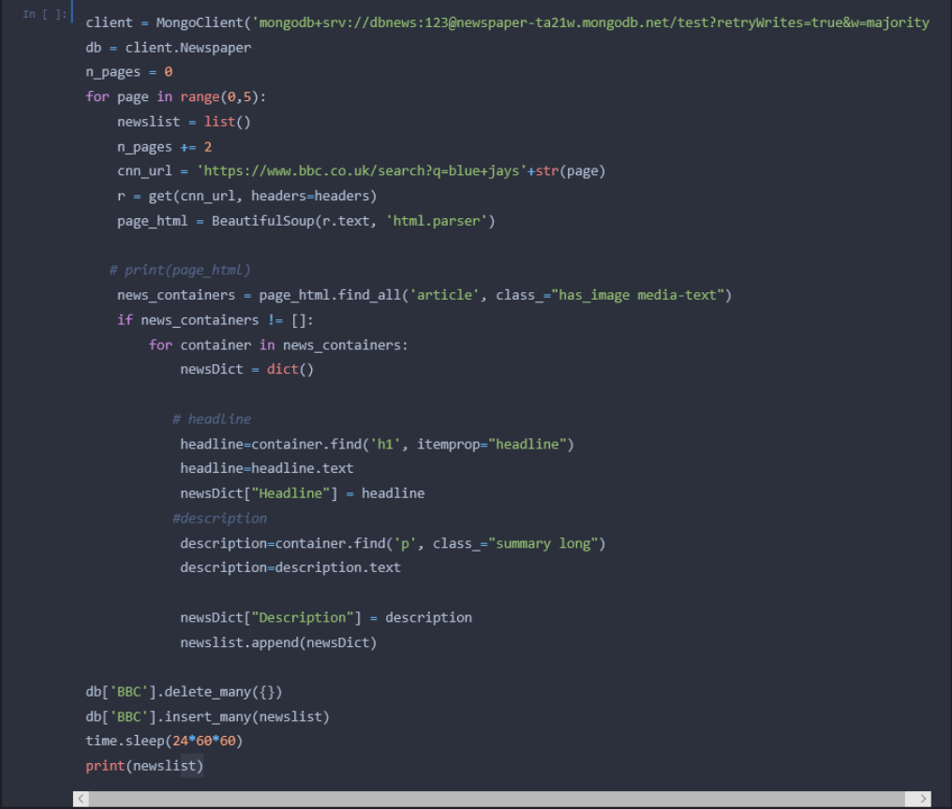
SCRAPPING CODE

Slide 6
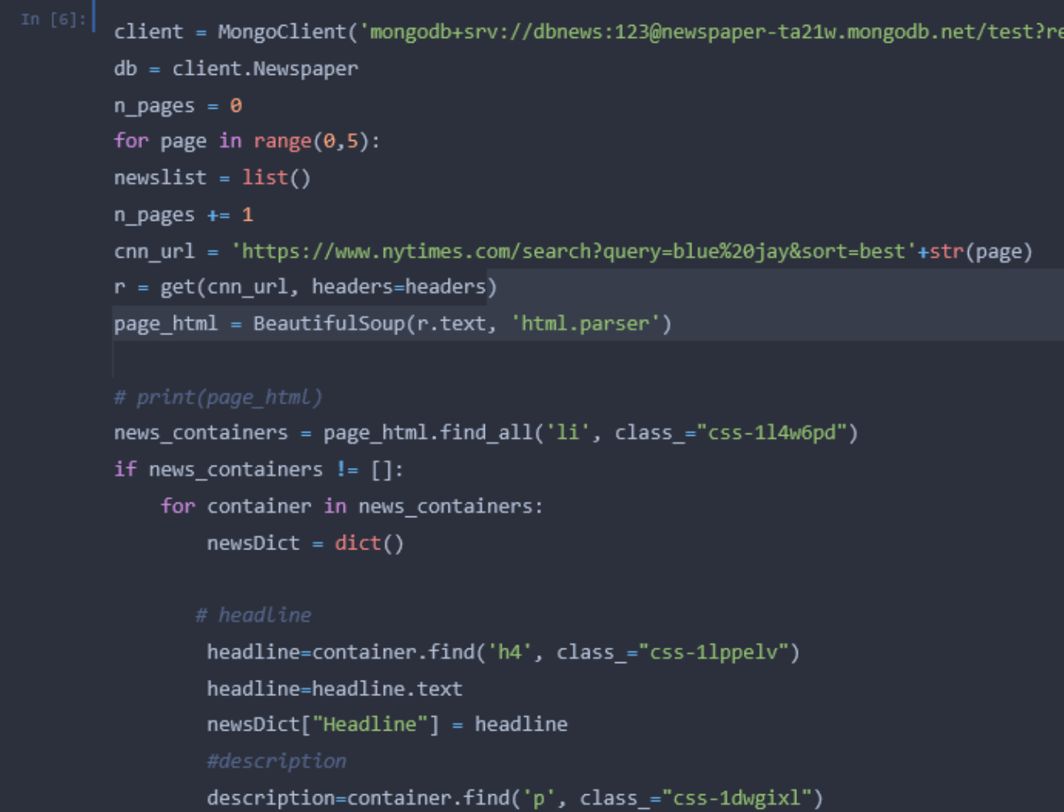

Slide 7
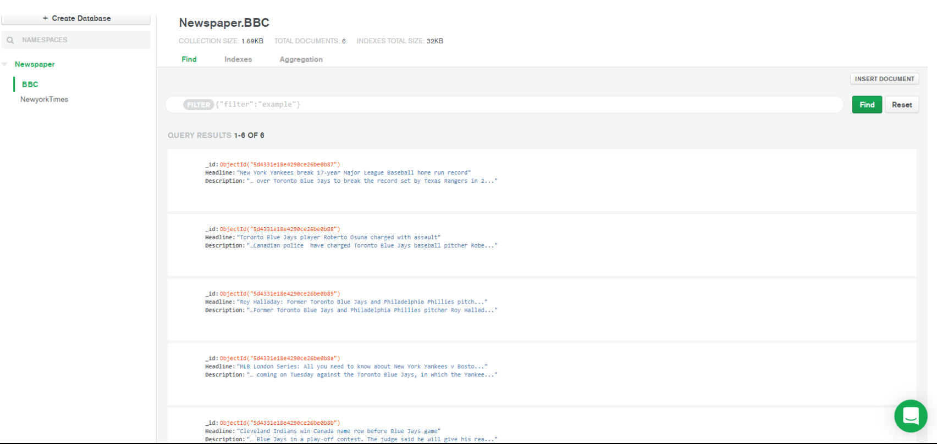
JSON STORAGE IN MONGODB

Slide 8
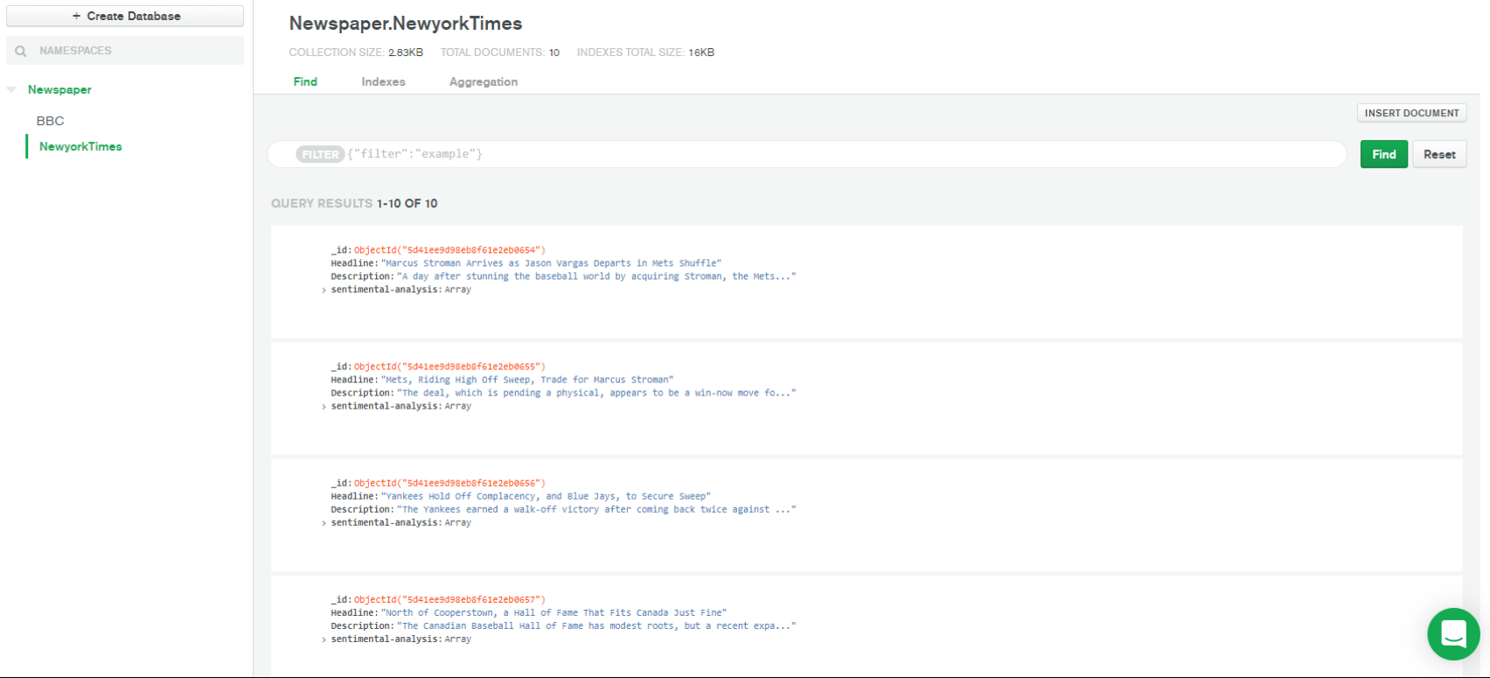

Slide 9
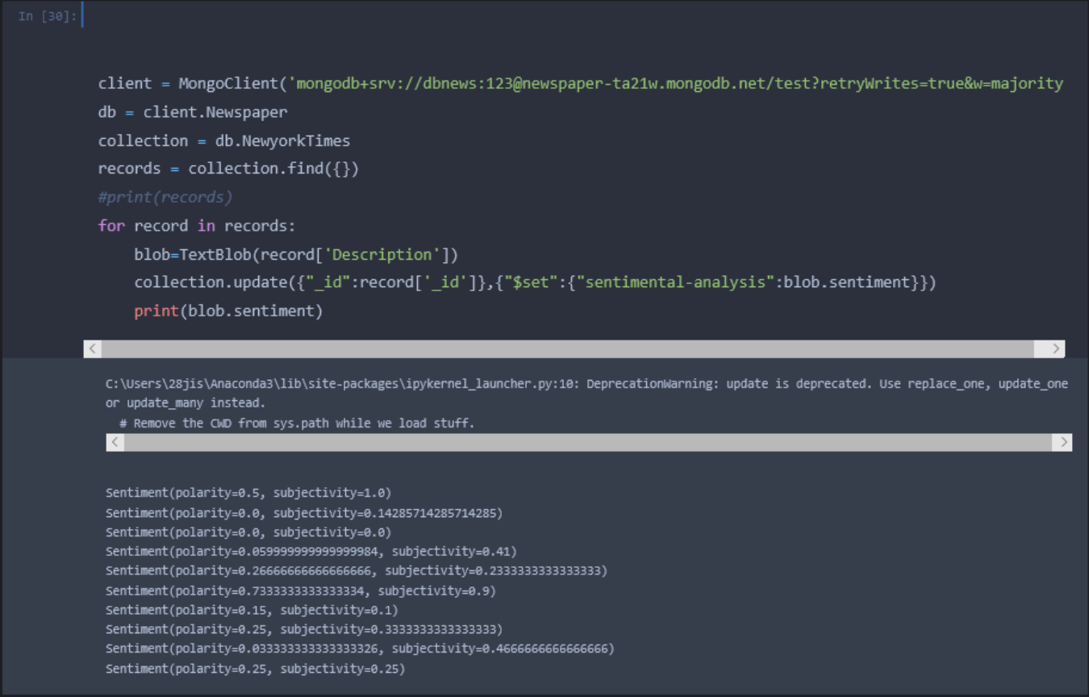

S E N T I M E N T A N A L Y S I S U S I N G TEXTBLOB

Slide 10
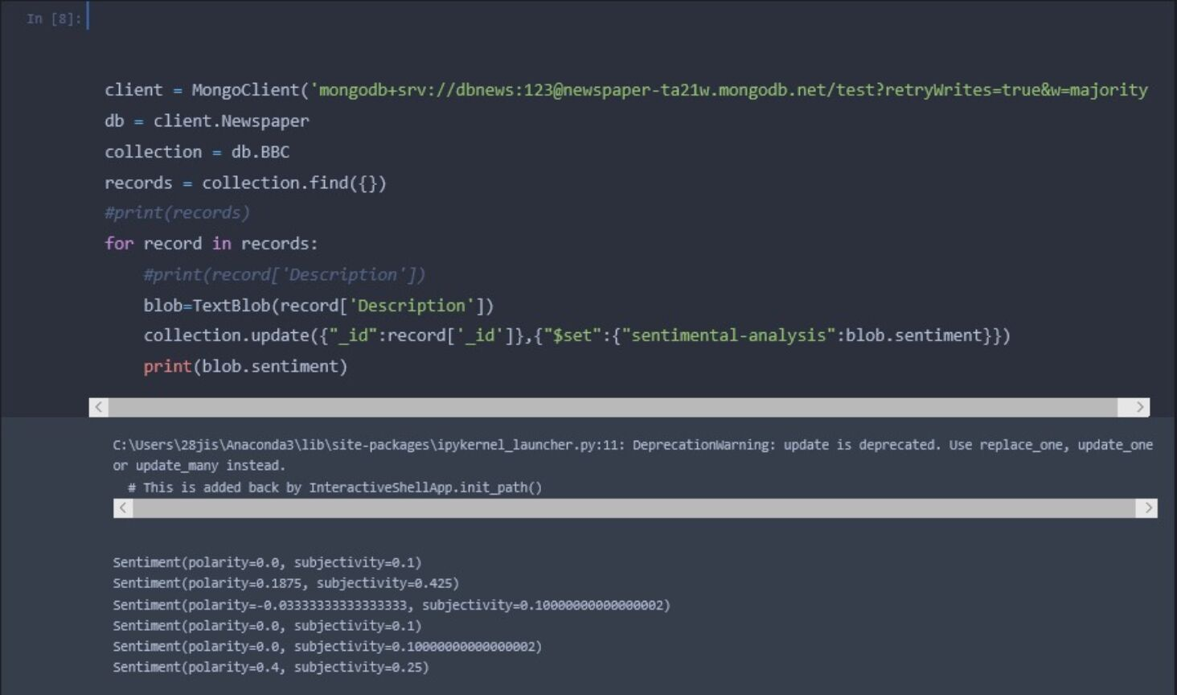

Slide 11
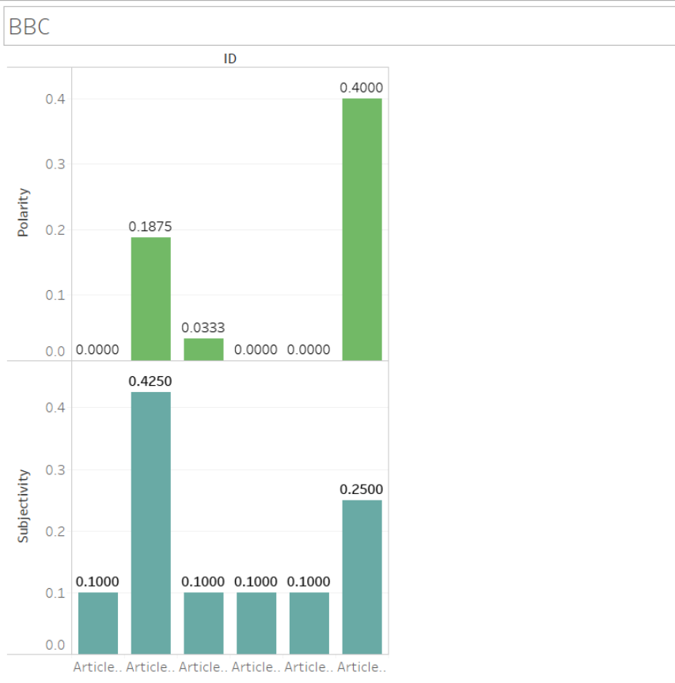
VISUALIZATION

Slide 12
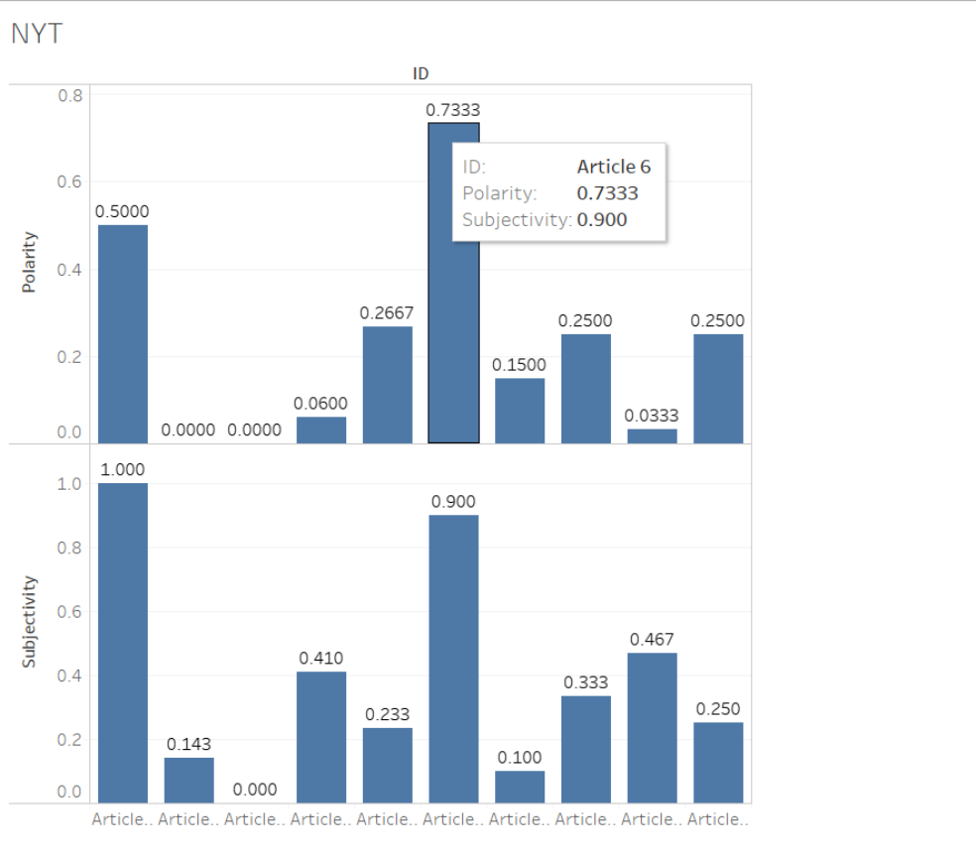

Slide 13
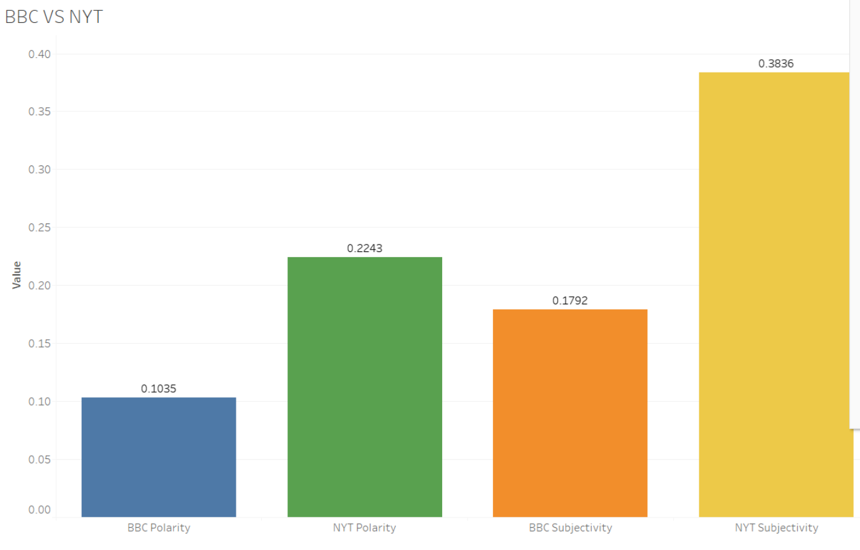

Slide 14
Thank you!

